Slide 1
OMG Threat Modeling and Sharing
Gerald Beuchelt, Demandware, Inc.
Cory Casanave, Model-Driven Solutions
Justin Stekervetz, DHS

Slide 2
Summary
Threat Modeling project kicked off in Dec 2013
Multi-phase approach
Initially: create Cyber Domain PIM and STIX PSM with UML Profile for NIEM
Expand to non-cyber domains
Progress so far
Provided preliminary UML version of STIX
Developed initial conceptual threat model
Some basic mappings from NIEM to STIX by ‘pivoting’ through conceptual model
Next steps
Expand conceptual model and solidify NIEM and STIX mappings
Identify additional information domains/sharing stacks for mapping
Explore additional use cases (including modeling and predictive analysis)
Explore integration with Risk Meta Model

Slide 3
Cross-Protocol/Conceptual Model
Benefits
Reduce number of point-to-point interoperability connections; reduce interoperability from N² to linear problem
Enable uniform semantic interoperability
Communities continue driving development of specific threat models
Disadvantages
Translations will be lossy
Communities need focus to define mappings from specific model to meta model

Slide 4
Model for Semantic Interoperability No Common Meta Model
PT XML (notional)
Cap XML
Physical Threat Model
CAP (Model)
IODef (model)
Snort (model)
IODef (protocol)
STIX PIM
Snort rules
STIX XML
STIX JSON

Slide 5
Model for Semantic Interoperability Conceptual Domain Model
PT XML (notional)
Cap XML
Physical Threat Model
CAP (Model)
IODef (model)
Snort (model)
IODef (protocol)
STIX PIM
Snort rules
STIX XML
‘Semantic Glue’
(i.e. Conceptual Threat Model)
STIX JSON

Slide 6
Pivoting with a Semantic Hook
“Source”
Data
Representation
Data representations (Schema & Instances)
Model data for a purpose using a technology
“Instances” are data structures (e.g. SQL tables or XML documents) – “facts” about the things in the world from some perspective
Conceptual Domain Models (CDM)
A conception of the world by a group of stakeholders – less purpose specific
“Instances” are things in the world – so can’t be in models
Using abstraction, we can have multiple representations of facts about the world in different data structures and technologies
Rules define how domain concepts can be represented in a particular form – rules can be simple and generic or heavyweight and specific, depending on the representation.
“Target”
Data
Representation
Represent
Rules
Conceptual Domain Models
(Models of the world)

Slide 7
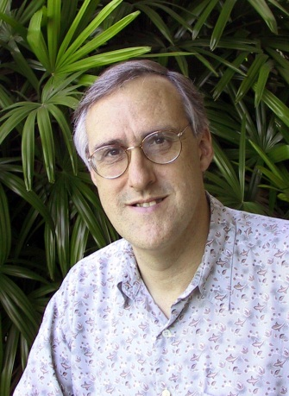
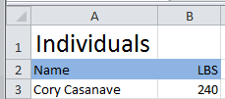

Example of “Pivoting” through a conceptual model
Concept of
“Cory Casanave”
There is an actual “Person”, Cory Casanave
There is a concept of this person shared in this room, right now
Here is one representation of him
“Person” is a shared concept, independent of data structures
There may also be shared agreement that Cory is a person and some other “facts”
“Cory Casanave” is a name for this person
He weighs 240 LBS
There are multiple data representations about Cory Casanave which may or may not agree
Those representations can be grounded in concepts (semantics), assisting federation
Concept of a
“Person”
<PersonType>
<NameText>Cory B. Casanave</NameText>
<Weight-LBS>234</Weight-LBS>
</PersonType>
XML
Representations
.
Excel
UML

Slide 8
Overview Conceptual Model

Slide 9
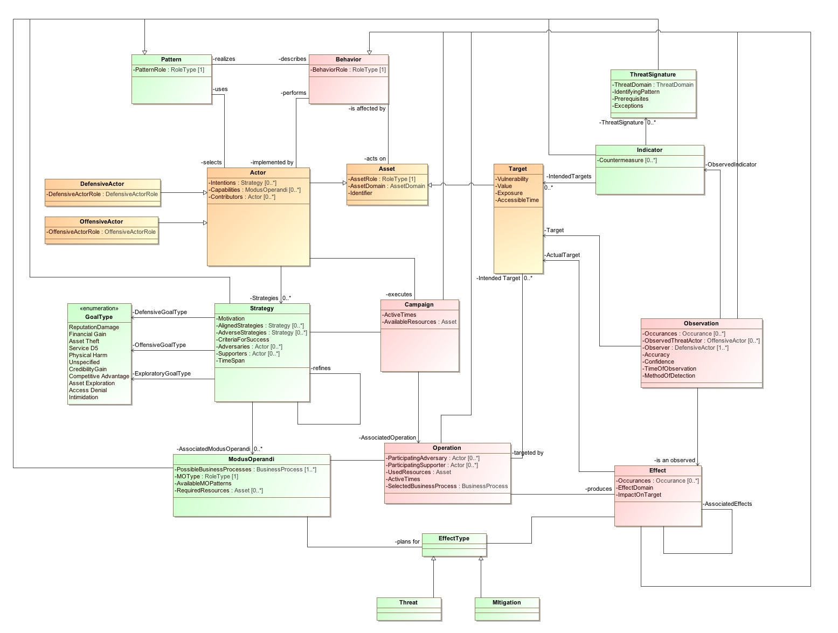

Slide 10
Overview Mapping to STIX and NIEM

Slide 11
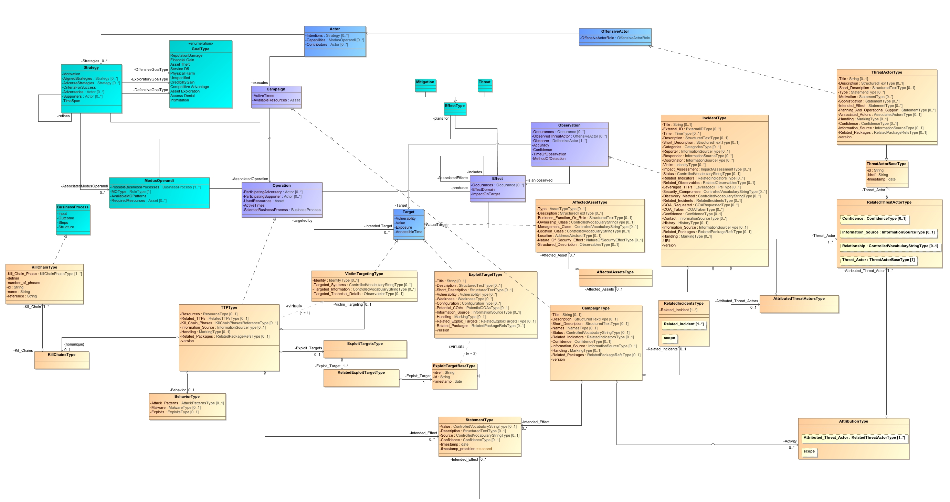

Slide 12
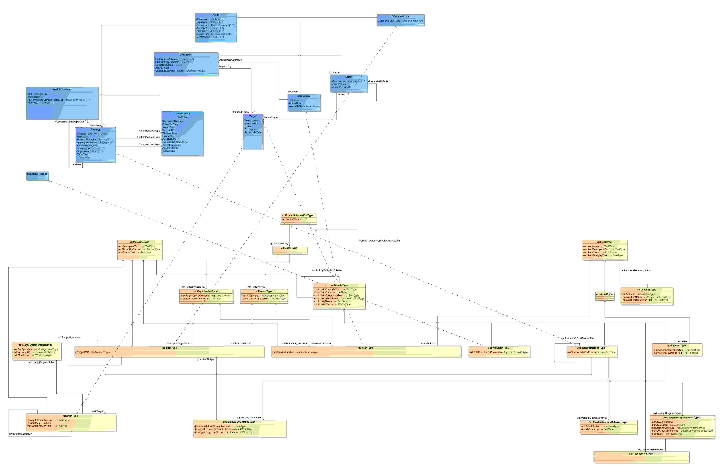

Slide 13
Use Case Work

Slide 14
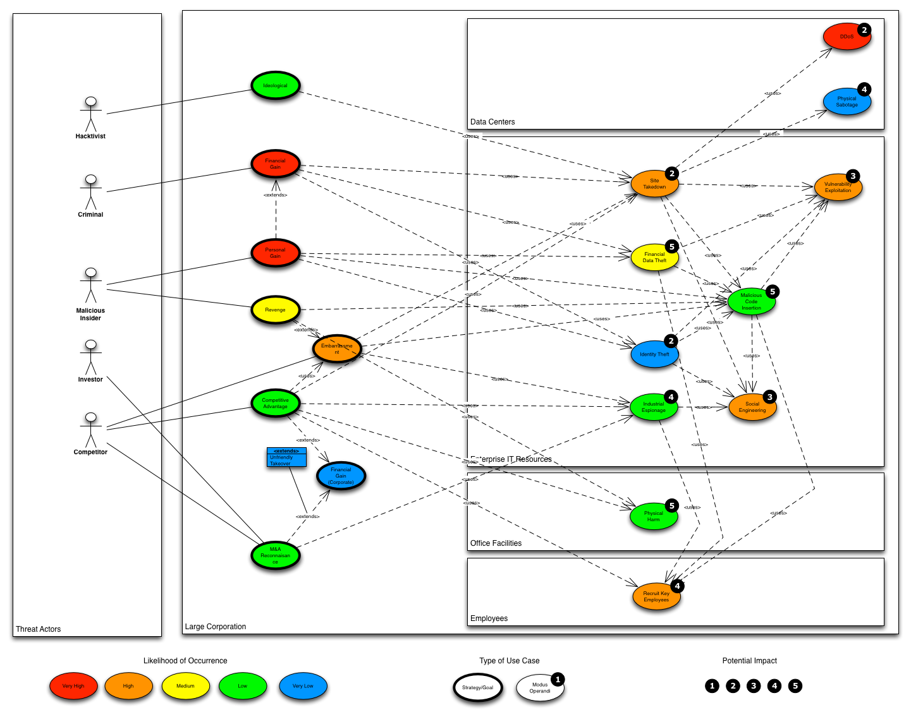

Slide 15
Use Case: Large Company
Company with multiple datacenters, office facilities, international business activity
Large number of deployed security systems, sensors
Firewalls, IDS/IPS, SIEM, monitoring systems, notification/alerting, etc.
Uses FW/Snort rules, STIX/TAXII, IODef, alarms for fire and intrusions, etc.
Physical and information security staff, some 24/7
Interoperable (but not uniform) threat monitoring and assessment

Slide 16
Use Case – Critical Infrastructure
Target: A group of organizations that collaboratively manage critical infrastructure and utilize Industrial Control Systems.
Power, water and other critical infrastructure are threatened by cyber and physical terrorism.
Industrial Control Systems are increasingly computer controlled and connected (directly or indirectly) to the internet and may embed compromised control hardware/software from questionable sources.

Slide 17
Notional Timeline

Slide 18
Call to Action
Email list threat-modeling@omg.org (Subscription via request@omg.org)
GitHub Pages https://github.com/omg-threat-modeling/phase1/
Weekly calls: Mondays, 2 pm ET
Join us!

Slide 19
Backup

Slide 20
Use Case: Large Company
Scenario 1a: External attack
TTPs: Spearphishing, stolen mobile devices, stolen hard tokens/credentials, office break-in, APT deployment, DDoS attacks
Goals:
Financial gain: identity theft, credit card fraud, stock market manipulation, extortion
Main target/concerns: systems
Systems involved: email/communications, end-user devices, physical locations, various security systems

Slide 21
Use Case: Large Company
Scenario 1b: External attack
TTPs: Spearphishing, stolen mobile devices, stolen hard tokens/credentials, office break-in, APT deployment, DDoS attacks
Goals:
Competitive advantage: stock market manipulation, reputation loss, poach on employee talent base, industrial espionage/intellectual property theft
Main target/concern: humans
Systems involved: email/communications, end-user devices, physical locations, various security systems

Slide 22
Use Case: Large Company
Scenario 2a: Insider threat
TTPs: Malicious activity (including disabling security systems, data exfiltration, data manipulation, backdoors/forged credentials, etc.), APT deployment, physical attack
Goals:
Financial gain: credit card fraud, identity theft, intellectual property theft, asset theft, industrial espionage, extortion
Main target/concerns: humans
Systems involved: servers and end-user devices, various security systems, physical security systems

Slide 23
Use Case: Large Company
Scenario 2b: Insider threat
TTPs: Malicious activity (including disabling security systems, data exfiltration, data manipulation, backdoors/forged credentials, etc.), APT deployment, physical attack
Goals:
Retaliation: attack on service availability, identity theft, reputation loss, physical damage and personal harm
Main target/concerns: humans and organizations
Systems involved: servers and end-user devices, various security systems, physical security systems

Slide 24
Use Case: Large Company
Scenario 2c: Insider threat
TTPs: Malicious activity (including disabling security systems, data exfiltration, data manipulation, backdoors/forged credentials, etc.), APT deployment, physical attack
Goals:
Espionage: intellectual property theft, industrial espionage
Main target/concern: humans and organizations
Systems involved: servers and end-user devices, paper files, various security systems, physical security systems

Slide 25
Use Case – Critical Infrastructure
Scenario 1 – North-East U.S. Power Grid attack by terrorists
An undetected and formerly unknown virus is planted in control systems emergency response software.
A physical attack on a substation initiates a cascading failure
Compromised control systems do not take substations and generating capacity off-line and introduce failure protocols, causing substantial failure of the physical infrastructure
Much of the power grid off-line for months

Slide 26
Use Case – Critical Infrastructure
Scenario 1 – Mitigations
Information from Control Systems, Field Monitors, Physical Security and User reports are integrated via a threat management console
Initial attack is recognized
Initial Cascade is recognized
Failure of control software generates incorrect action, which is recognized as an additional threat
Integrated threat management creates alert, manual control over infrastructure prevents widespread failure

